Slide 1
Export Compliance
New Employee Training

Slide 2
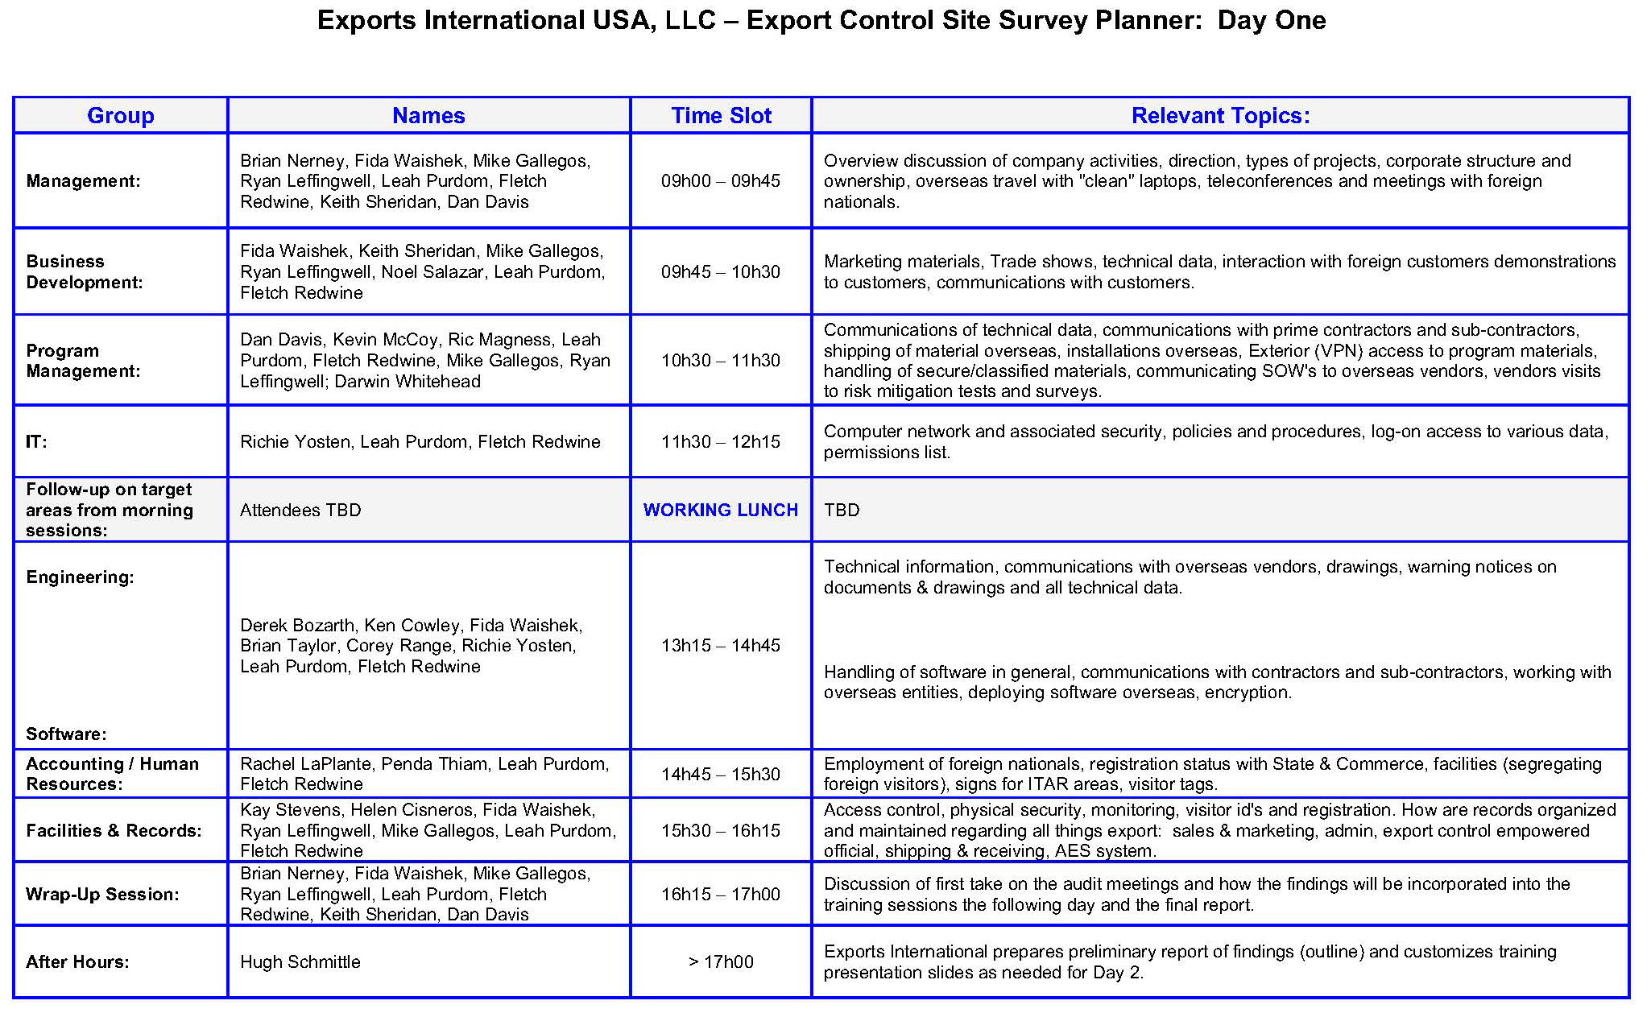
Day 1 - Site Survey
Agenda outline

Slide 3

Day 2 - Compliance Training
RSG Training Modules
Time | Topic
9:15-11:15 a.m. | ITAR/EAR export classification
11:15-12:00 p.m. | Recordkeeping
12:00-1:00 p.m. | Working Lunch / Exports 101
1:00-1:30 p.m. | Morocco personnel orientation
1:45-2:30 p.m. | TAA & IFO licenses
2:30-3:00 p.m. | License Exemptions/Exceptions
3:00-3:30 p.m. | ITAR/EAR penalties for violations
3:30-4:00 p.m. | Wrap-up

Slide 4
Classification:
Order of Review

Slide 5

First, Rule ITAR In or Out
Classify: Order of Review
Review the USML, found in ITAR Part 121.
Defense articles can be "enumerated" (e.g. "F/A-18 E/F" or "described" (e.g. "Fighters, fighter bombers, and fixed-wing attack aircraft").
Pay close attention to language in regs.
Use the same "enumerated"/"described" sensitivity when evaluating ECCNs.
"Parts"/"components" can appear in USML category paragraphs other than the main parts/components paragraph in any category.

Slide 6
Note SME & MTCR status
Classify: Order of Review
Significant Military Equipment (“SME”) is still denoted with an asterisk in the USML paragraph
Missile Technology Control Regime (“MTCR”) will be indicated by the parenthetical ‘‘(MT)’’ at the end of a U.S. Munitions List paragraph
If the term "specially designed" appears in a candidate USML category, then walk through the specially-designed definition/algorithm, the ITAR version being found at § 120.41.

Slide 7
If not captured by USML, then start with EAR 600-Series ECCNs
Classify: Order of Review
The 600-series of ECCNs was created to capture the parts/components that moved from ITAR to EAR.
Start with the ".y" paragraph, a very specific list of relatively trivial parts, mostly exportable NLR.
Then the ".x" paragraph, the general parts & components section of 600-series hardware ECCNs.
Read the entire 600-series ECCN at issue, e.g. 9A610. "Parts & components" are sometimes partially carved out in other parts of an ECCN, in addition to the ".x" and ".y" paragraphs.
Sometimes that ITAR terminology "enumerated" or "described" appears in an ECCN, either cross-referencing an ITAR USML category or another ECCN.

Slide 8
Rules of thumb for all ECCNs
Classify: Order of Review
ECCNs all have 5 characters, with the 2nd being a letter: A = hardware; B = tooling/test Equipment; C = materials; D = software; E = technology/tech-data. This can help your search for correct classification.
If the term "specially designed" appears in a candidate ECCN, then walk through the specially-designed definition/algorithm, the EAR version being found at Part 772, page 37-40.
When you see references in an ECCN to EAR or ITAR citations, you must read those to truly understand the ECCN you are reading.
Consider "families" of ECCN, e.g. 6A008, 6A108, 6A998.

Slide 9
If not captured by a 600-Series ECCN, then move to the rest of the CCL
Classify: Order of Review
Outside the 600-series of ECCNs, the higher the last 2 digits in an ECCN, the less sensitive it is. For example:
Aero gas turbine engines under 9A001 have the most restrictive reasons for control in that "family", while
(i.e., 9A001, 9A101; 9A111, 9A991)
Aero gas turbine engines under 9A991 can go almost anywhere in the world, including China, without an export license in most cases.
If no ECCN captures your item, then it is EAR99.
Document each classification made; include your annotated ITAR/EAR excerpts; log into your classification matrix.

Slide 10
“Specially Designed”
- Walking through “Catch & Release” -

Slide 11
“Specially Designed” definition
“Specially Designed”
ECR moving majority of parts from ITAR to EAR
Definition in ITAR §120.41 and EAR §772.1
Mirrors definitions with minor differences
Has a “catch” and “release” construction, found in the Definition’s Paragraphs (a) and (b), respectively.
Only applicable to revised USML categories

Slide 12
Notes 1 and 2 of “Specially Designed”
“Specially Designed”
These “Notes” need to be kept in mind as we work through “Specially Designed”:
Note 1: The term “enumerated” refers to any article on the U.S. Munitions List or the Commerce Control List and not in a “catch all” paragraph.
Note 2: The term “commodity” refers to any article, material, or supply, except technology/technical data or software.
More “Notes” appear in the definition, so truly understanding how “Specially Designed” works requires iterations and practice.

Slide 13
Paragraph (a) of “Specially Designed”
“Specially Designed”
This is the “catch” paragraph of the definition
“(1) as a result of development, has properties peculiarly responsible for achieving or exceeding the controlled performance levels, characteristics, or functions described in the relevant U.S. Munitions List paragraph.” or
(2) is a part (see §120.45 (d) of this subchapter), component (see §120.45 (b) of this subchapter), accessory (see §120.45 (c) of this subchapter), attachment (see §120.45 (c) of this subchapter), or software for use in or with a defense article.
As you can see, this captures most everything on the USML, so without a “release” mechanism, there would be no ECR, and no transfer of control from the USML to the CCL

Slide 14
Paragraph (b) of “Specially Designed”
“Specially Designed”
Now we start to see the “release” paragraphs of the “Specially Designed” definition, in a number of exclusions from the “capture”.
Only one exclusion is needed to effect “release”.
Notes regarding the definition of a “catch-all”
Note to Paragraph (b) in the ITAR definition
Note 2 in the EAR definition

Slide 15
Paragraph (b)(1) of “Specially Designed”
“Specially Designed”
Is subject to the EAR pursuant to a commodity jurisdiction determination (ITAR)

Slide 16
Paragraph (b)(2) of “Specially Designed”
“Specially Designed”
is, regardless of form or fit, a fastener (e.g., screws, bolts, nuts, nut plates, studs, inserts, clips, rivets, pins), washer, spacer, insulator, grommet, bushing, spring, wire, or solder

Slide 17
Paragraph (b)(3) of “Specially Designed”
“Specially Designed”
Has the same function, performance capabilities, and the same or “equivalent” form and fit as a commodity or software used in or with a commodity that:
(i) is or was in production (i.e., not in development); and
(ii) is not enumerated on the U.S. Munitions List

Slide 18
ITAR Notes to (b)(3) of
“Specially Designed”
“Specially Designed”
Note 1: Definitions of “production”
Note 2: Definition of “development”
Note 3: When an item is “production” reverts to “development”
Note 4: Clarification of “equivalent”

Slide 19
Paragraph (b)(4) of “Specially Designed”
“Specially Designed”
This (b)(4) has theoretical potential for reducing ITAR overhead, if you can consider this in early stages of product RDT&E.
was or is being developed with knowledge that it would be for use in or with both defense articles enumerated on the U.S. Munitions List and also commodities not on the U.S. Munitions List.
Cannot be done retroactively with an ITAR item
Must be documented contemporaneously
Must be “real” intent, not just an empty assertion

Slide 20
Paragraph (b)(5) of “Specially Designed”
“Specially Designed”
was or is being developed as a general purpose commodity or software, i.e., with no knowledge for use in or with a particular commodity (e.g., a F/A-18 or HMMWV) or type of commodity (e.g., an aircraft or machine tool)

Slide 21
Notes to (b)(4) and (b)(5) of “Specially Designed”
“Specially Designed”
Identifies the documentary requirements for applying the exclusions in paragraphs (b)(4) and (b)(5)
Provides definition of “knowledge” consistent with the EAR

Slide 22
Classifying Products
&
Does It Need a License?

Slide 23

Classifying: Page at a Glance
Classification
ITAR or EAR?
If ITAR, it’s one of 21 categories on the USML
If EAR, must determine ECCN from the CCL
When you have the ECCN
Reasons for Control
Country Chart
Are there exceptions?
Then NLR or apply for a DOC license

Slide 24
Classifying Your Product
Classification
Is it on the US Munitions List (USML)? – defense item, State jurisdiction - Classification by USML category
Is it on the Commerce Control List (CCL)? – dual use item, Commerce jurisdiction – classification by export control classification number (ECCN)
Is it clearly commercial but you can’t find it in the CCL? – Commerce jurisdiction (EAR99)
You believe it is a dual use item under Commerce but you are not sure what the ECCN is? Ask Commerce to either validate your self classification or to provide you with a Commodity Classification
Not sure who has jurisdiction? Ask State for a Commodity Jurisdiction determination

Slide 25
Classification Rules-of-Thumb
Classification
Something counts as tech data under the EAR or the ITAR articles if:
You would not want to post on your Website because the disclosure could lead to reverse-engineering, or
You would not put the info in trade show brochures
Product classification is most often self-classification.
Often makes sense nowadays to follow up with a CCATS (Commerce) or a CJ (State), especially if you plan to export to trickier destinations.

Slide 26
ITAR “defense articles” [§120.6 def.]
Classification
Defense article means any item or technical data designated in §121.1 of this subchapter. The policy described in §120.3 is applicable to designations of additional items. This term includes technical data recorded or stored in any physical form, models, mockups or other items that reveal technical data directly relating to items designated in §121.1 of this subchapter. It does not include basic marketing information on function or purpose or general system descriptions.

Slide 27
ITAR “defense services” [§120.9 def.]
Classification
(1) The furnishing of assistance (including training) to foreign persons, whether in the United States or abroad in the design, development, engineering, manufacture, production, assembly, testing, repair, maintenance, modification, operation, demilitarization, destruction, processing or use of defense articles;
(2) The furnishing to foreign persons of any technical data controlled under this subchapter (see §120.10), whether in the United States, or
(3) Military training of foreign units and forces...

Slide 28
ITAR “tech data” [§120.10 def.]
Classification
(1) Information, other than software as defined in §120.10(a)(4), which is required for the design, development, production, manufacture, assembly, operation, repair, testing, maintenance or modification of defense articles. This includes information in the form of blueprints, drawings, photographs, plans, instructions or documentation.
(2) Classified information relating to defense articles and defense services;
(3) Information [in] an invention secrecy order;

Slide 29
ITAR “tech data” [§120.10 def.]
Classification
(4) Software as defined in §121.8(f) of this subchapter directly related to defense articles;
Note: This definition does not include information concerning general scientific, mathematical or engineering principles commonly taught in schools, colleges and universities or information in the public domain as defined in §120.11. It also does not include basic marketing information on function or purpose or general system descriptions of defense articles.

Slide 30
ITAR aircraft “tech data” [USML def.]
Classification
USML Cat. VIII(i) - Technical data (see §120.10 of this subchapter) and defense services (see §120.9 of this subchapter) directly related to the defense articles described in paragraphs (a) through (h) of this category and classified technical data directly related to items controlled in ECCNs 9A610, 9B610, 9C610, and 9D610 and defense services using classified technical data. (See §125.4 of this subchapter for exemptions.) (MT for technical data and defense services related to articles designated as such.)

Slide 31
What is “Dual-Use”?
Classification - Dual-Use
§730.3 The convenient term “dual use” is sometimes used to distinguish the types of items covered by the EAR from those that are covered by the regulations of certain other U.S. government departments and agencies with export licensing responsibilities. In general, the term dual use serves to distinguish EAR-controlled items that can be used both in military and other strategic uses and in civil applications from those that are weapons and military related use or design and subject to the controls of the ITAR.
Note, however, that although the short-hand term dual use may be employed to refer to the entire scope of the EAR, the EAR also apply to some items that have solely civil uses.

Slide 32
Classifying under the ITAR
Classification - ITAR / USML
So forget “dual-use” concept. Too confusing. An item’s jurisdiction is either EAR or ITAR
If RSG designs or modifies a “commercial” part/component for a military use or purpose, that item is ITAR
If you do not design or modify a “commercial” part in that manner, but qualify the part for your military customer, that item remains commercial
ITAR § 120.3: The intended use of the article or service after its export (i.e. , for a military or civilian purpose), by itself, is not a factor in determining whether the article or service is subject to the controls of [the ITAR].

Slide 33
Classifying as ITAR (Cont.)
Classification - ITAR / USML
No matter what else you may think -- even if you are ultimately correct -- an “ITAR” designation by your customer, work order, or drawing placard means you must consider that item to be under ITAR jurisdiction.
You are Normally not entitled to second-guess your customer. This is because overcoming an ITAR classification is done with a formal CJ, or Commodity Jurisdiction application to State Dep’t.
State Department’s rules for CJs requires them to be submitted by the manufacturer, or else by a third party if the manufacturer writes an approval letter for the third party to do so.

Slide 34
Classifying under the EAR
Classification - EAR / CCL
This is much more complex than ITAR classifications
Search through the CCL’s “families” of ECCNs
Use keyword “string” searches to create a short-list
If no ECCN effects “capture” of the item, then: EAR99
If ambiguous between ITAR/USML and EAR/CCL: do CJ
If ambiguous between two ECCNs, do CCATS
Note: neither a CJ nor a CCATS will pronounce on a class of good. Normally specific to a make/model number.

Slide 35
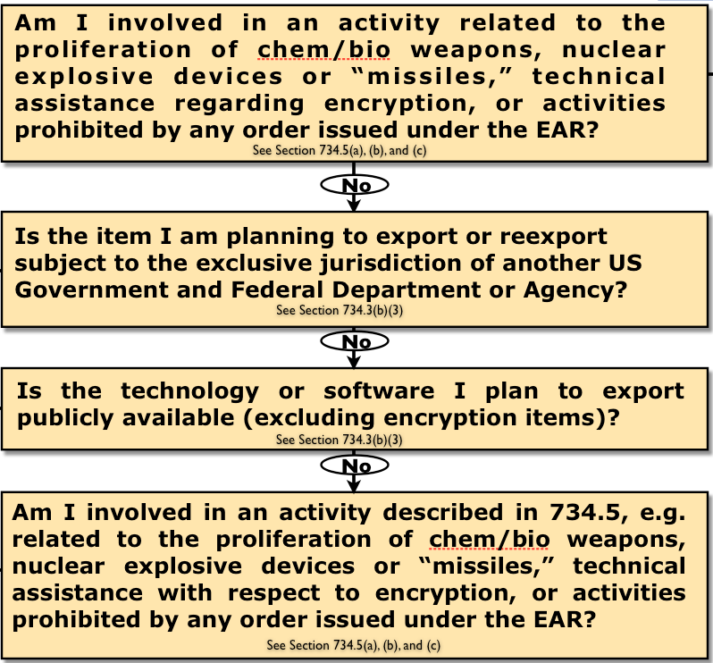
Subject to the EAR?
[Chart source: the EAR]
Classification
Not
S
u
b
j
e
c
t
t
o
E
A
R
Yes
Yes
S
u
b
j
e
c
t
t
o
E
A
R
Yes
Yes

Slide 36
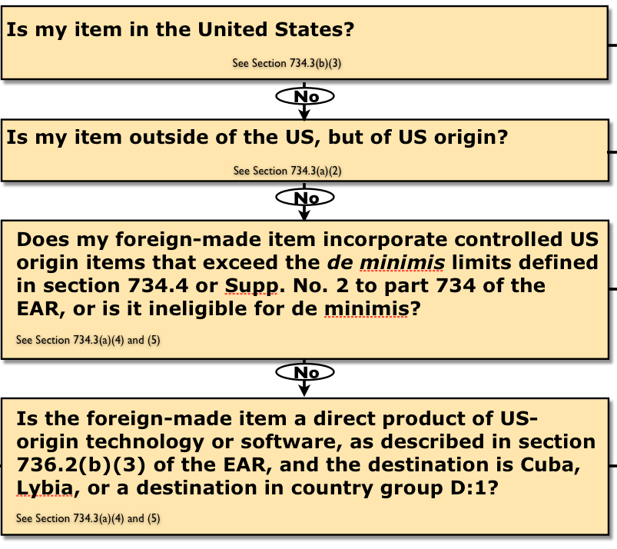
Subject to the EAR?
[Chart source: the EAR]
Classification
Not
Yes
S
u
b
j
e
c
t
t
o
E
A
R
Yes
S
u
b
j
e
c
t
t
o
E
A
R
Yes
No
Yes

Slide 37
Commerce Dept. Export Control Decision Tree
Classification
Subject to the EAR
(See 734.205)
No
Exit the EAR
Yes
ECCN
Yes
Is your item classified under an ECCN on the CCL?
(See Supp. No. 1 to Part 774)
Do General Prohibitions 4-10 apply?
(See 736.2(b)(4-10))
No
EAR99
Yes
Do General Prohibitions 4-10 apply?
(See 736.2(b)(4-10))
No
Is there an “X” in the box?
(Using the Commerce Country Chart and the CLL)
(Supp. No. 1 to Part 738 & Supp. No. 1 to Part 774)
“No License Required” (NLR)
(See 732.5(a)(1)(ii) & 758.1(a)(3))
No
No
Yes
Yes
Is a License Exception Available?
(See part 740, including 740.2 “restrictions that apply to all license exceptions”)
Use License Exception
(See Part 740.1)
Yes
No
Submit an application for license
(see Part 748)
[Chart source: the EAR]

Slide 38
Classification Summary Flowchart
Procedure for Empowered Official to Follow
Classification

Slide 39

ECCN 3A611
Military electronics and related items
Classification & SNAP-R
3A611 Military electronics
License Requirements
Reason for Control: NS, RS, AT, UN
Control(s) Country Chart
NS applies to entire entry NS Column 1
except 3A611.y
RS applies to entire entry RS Column 1
except 3A611.y
AT applies to entire entry AT Column 1
UN applies to entire entry See §746.1(b) for
except 3A611.y UN controls
License Exceptions
LVS: $1500 for 3A611.a, .d thru .h,
and .x; N/A for ECCN 3A611.c
GBS: N/A
CIV: N/A
STA: Paragraph (c)(2) of License Exception STA (§740.20(c)(2) of the EAR) may not be used for any item in 3A611.

Slide 40
ECCN 3A611 (continued)
Military electronics and related items
Classification & SNAP-R
.a: Electronic "equipment," "end items" and "systems" not on USML or 600-series "specially designed" for a military application
.b: thru .d [Reserved]
.e: High frequency surface wave radar, except marine traffic ctrl
.f: Application-specific integrated circuits ("ASICs") and programmable logic devices ("PLD") programmed for 600-series
.g: Printed circuit boards & populated circuit card assemblies "specially designed" for 600-series
.h: Multichip modules "specially designed" for 600-series
.i-.w [Reserved]
.x: parts, components, accessories, attachments that are “specially
designed” for USML Cat. XI or for other 3A611 items
.y: specifically enumerated parts, components, accessories, attachments that are “specially designed”

Slide 41
Country Charts re 3A611
Military electronics and related items
Classification & SNAP-R
3A611 - License Requirements
Reason for Control: NS, RS, AT, UN
Control(s) Country Chart
NS applies to entire entry except 3A611.y. NS Column 1
RS applies to entire entry except 3A611.y RS Column 1
AT applies to entire entry AT Column 1
UN applies to entire entry except 3A611.y See §746.1(b) for UN controls

Slide 42
Country Charts re 3E611
"Technology" "required" for military electronics
Classification & SNAP-R
3A611 - License Requirements
Reason for Control: NS, RS, AT, UN
Control(s) Country Chart
NS applies to entire entry except 3A611.y. NS Column 1
RS applies to entire entry except 3A611.y RS Column 1
AT applies to entire entry AT Column 1
UN applies to entire entry except 3A611.y See §746.1(b) for UN controls

Slide 43
Recordkeeping

Slide 44
Records to keep
Export License or Other Approval
Documents Supporting the Approval Request
Invoice
Packing Slip
Bill of Lading
Airway Bill
Purchase Order
Self-Classifications
ITAR & EAR Recordkeeping
Summary of the minimum records required:
CJ and CCATS Classifications
DSP-83, BIS-711, or other EUS
Delivery Verification
Foreign Import Certificate
Technical Data Exemption
Other Exemptions and License Exceptions
Visits and Tours by Non-US Persons
TAA / MLA - data transfers
Compliance starts & ends with proper records

Slide 45
More about Record-keeping
ITAR & EAR Recordkeeping
Many “controlled” tech data exports, whether under a license or exemption, effectively bypass this system, so you must keep a detailed log.
No AES entry for tech data exports - AES is only for hardware.
9 years minimum: the rule of thumb for keeping export records
A tickler system must be established for export records: certain license provisos; renewal dates of DTC registration & digital certificates, and so on. Other required notifications are event-based, such as material changes to the data in the DS-2032 or various prior notifications, are also needed in the system.

Slide 46
For how long?
ITAR & EAR Recordkeeping
Basic Rule: 5 years after any export, or the expiration of related license
Statute of limitations is 5 years
Commerce license is 4 years (used to be 2 years until the ECR)
State DSP-form license is 4 years
TAA / MLA / WDA is 10 years
Therefore, except for TAAs, good rule of thumb is 9 years
With TAAs, the rule of thumb is 15 years
ITAR § 122 applies - §122.4 for “material changes” to DS-2032
Most material changes must be reported within 5 days

Slide 47
Recordkeeping for Exemptions
ITAR Recordkeeping
ITAR § 123.26 - Recordkeeping for exemptions
Any person engaging in any export, reexport, transfer, or retransfer of a defense article or defense service pursuant to an exemption must maintain records of each such export, reexport, transfer, or retransfer. The records shall, to the extent applicable to the transaction and consistent with the requirements of §123.22 of this subchapter, include the following information: A description of the defense article, including technical data, or defense service; the name and address of the end-user and other available contact information (e.g., telephone number and electronic mail address); the name of the natural person responsible for the transaction; the stated end-use of the defense article or defense service; the date of the transaction; the Electronic Export Information (EEI) Internal Transaction Number (ITN); and the method of transmission. The person using or acting in reliance upon the exemption shall also comply with any additional recordkeeping requirements enumerated in the text of the regulations concerning such exemption (e.g., requirements specific to the Defense Trade Cooperation Treaties in §126.16 and §126.17 of this subchapter).

Slide 48
Recordkeeping per the EAR
EAR Recordkeeping
EAR Part 772 - Definitions - “Export Control Document”
“A license; application for license; any and all documents submitted in accordance with the requirements of the EAR in support of, or in relation to, a license application; application for International Import Certificate; Delivery Verification Certificate or similar evidence of delivery; Electronic Export Information (EEI) on the Automated Export System (AES) presented in connection with shipments to any country; a Dock Receipt or bill of lading issued by any carrier in connection with any export subject to the EAR and any and all documents prepared and submitted by exporters and agents pursuant to the export clearance requirements of Part 758 of the EAR; a U.S. exporter's report of request received for information, certification, or other action indicating a restrictive trade practice or boycott imposed by a foreign country against a country friendly to the United States, submitted to the U.S. Department of Commerce in accordance with the provisions of Part 760 of the EAR; Customs Form 7512, Transportation Entry and Manifest of Goods, Subject to Customs Inspection and Permit, when used for Transportation and Exportation (T.& E.) or Immediate Exportation (I.E.); and any other document issued by a U.S. Government agency as evidence of the existence of a license for the purpose of loading onto an exporting carrier or otherwise facilitating or effecting an export from the United States or any reexport of any item requiring a license.”

Slide 49
Recordkeeping for Exceptions
EAR Recordkeeping
Part 740.1(f): “Records of transactions involving exports under any of the License Exceptions must be maintained in accordance with the recordkeeping requirements of Part 762 of the EAR.”
Part 762: This should be read separately, in detail, but includes these:
Export control documents as defined in Part 772. | Restrictive trade practice or boycott documents and reports
Memoranda | Invitations to bid
Notes | Books of account
Correspondence | Financial records
Contracts | How long? 5 years after license exp.

Slide 50
Recordkeeping for Exceptions
EAR Recordkeeping
Special recordkeeping for ECCNs 2A983, 2A984, 2D983 and 2D984, and “600 Series” ECCNs.
A description of the item replaced, repaired or serviced;
The type of repair or service;
Certification of the destruction or return of item replaced;
Location of the item replaced, repaired or serviced;
The name and address of those who received the items for replacement, repair, or service;
Quantity of items shipped; and
Country of ultimate destination.

Slide 51
Export Control 101: Overview of the System

Slide 52


Main Export Regulations
ITAR & EAR - Major updates started Oct 2013, and continuing …
USG Export Regulations
International Traffic in Arms
Regulations (ITAR)
Export Administration
Regulations (EAR)

Slide 53
How NOT to Approach Export Compliance Issues...
Yes Violation ?
No
Solving Export Problems
No
No
Yes
Don’t Mess With It !
Yes
Did You Mess With It ?
You Idiot !
You Idiot !
No
No
Does Anyone Else Know ?
You’re So Screwed !
Will
It Blow Up In Your Face ?
You’re So Screwed !
You’re So Screwed !
Yes
Yes
Can You
Blame Someone
Else ?
No
No
No
No
Hide It
Look the Other Way
Hide It
Yes
No License Required
(NLR)
No License Required
(NLR)

Slide 54
Key Elements of Compliance
ITAR & EAR
Key Compliance Points
“Export” can happen anywhere, by any employee
Basic knowledge of export rules required by all
Affects the whole transaction cycle, from new customer inquiry to shipping & receiving
- Record-keeping (for 9 years)
- Human Resources
- Physical plant security procedures
- Engineering Services
- IT (unauthorized local access; VPN issues, etc.
- Travel with laptops and smartphones
- Inter-divisional technical exchanges
- How proposals are generated

Slide 55
ITAR says what is an Export?
ITAR 120.17
ITAR Overview
Sending or Taking a Defense Article out of the United States
Disclosing “controlled” info, by any means, or transferring a Defense Article to a Foreign Person in the United States or Abroad.
Performing a Defense Service on behalf of, or for the benefit of, a Foreign Person in the United States or Abroad.
Tech data and defense services definitions prominently in export rules

Slide 56
U.S. Munitions List (USML)
ITAR Overview
Code | Description
I | Firearms, Close Assault Weapons & Combat Shotguns
II | Guns and Armament
III | Ammunition/Ordnance
IV | Launch Vehicles, Guided Missiles, Ballistic Missiles, Rockets, Torpedoes, Bombs and Mines
V | Explosives and Energetic Materials, Propellants, Incendiary Agents and Their Constituents
VI | Surface Vessels of War and Special Naval Equipment
VII | Ground Vehicles
VIII | Aircraft & Associated Equip.
IX | Military Training Equiment
X | Protective Personnel Equip.
XI | Military Electronics
Code | Description
XII | Fire Control, Range Finder, Optical and Guidance and Control Equipment
XIII | Materials & Miscellaneous Articles
XIV | Toxicological Agents, Including Chemical Agents, Biological Agents, Associated Equip.
XV | Spacecraft Systems and Associated Equipment
XVI | Nuclear Weapons Related Articles
XVII | Classified Articles, Technical Data & Defense Services Not Otherwise Enumerated
XVIII | Directed Energy Weapons
XIX | Gas Turbines & Assoc.
XX | Submersible Vessels & Related Articles
XXI | Articles, Data & Defense Services Not Otherwise Enumerated
I(d) Combat
Shotguns
I(g) Breech etc.
I(h) Parts
I(i) Tech Data
XII(a) FCS etc.
XII(c) NVG etc.
XII(e) Parts
XII(f) Tech Data
II(a) Over 50 cal.
II(j) Tech Data
II(k) Tech Data
Includes howitzers, mortars, cannons, recoilless rifles, etc.
III(d) Parts
III(e) Tech Data
- Various -
IV(h) Parts
IV(i) Tech Data
- Various -
XIV(m) Tech Data
- Various -
XV(e) Parts
XV(f) Tech Data
V(f) Parts
V(g) Tech Data
- Various -
XVI(d) Parts
XVI(e) Tech Data
VI(f) Parts
VI(g) Tech Data
VII(g) Parts
VII(h) Tech Data
VIII(h) Parts
VIII(i) Tech Data
XVIII(e) Parts
XVIII(f) Tech Data
IX(d) Parts
IX(e) Tech Data
XIX(f) Parts
XIX(g) Tech Data
X(d) Parts
X(e) Tech Data
XX(c) Parts
XX(d) Tech Data
XI(c) Parts
XI(d) Tech Data
(Note: Categories IV-XXI are now rewritten, under the ECR program.)
USML List updated as of Jan 1, 2018

Slide 57
U.S. Munitions Import List (USMIL)
USMIL — for now — is a subset of the U.S. Munitions List (USML)
ITAR Overview
Code | Description
I | Firearms, Close Assault Weapons & Combat Shotguns
II | Guns and Armament
III | Ammunition/Ordnance
IV | Launch Vehicles, Guided Missiles, Ballistic Missiles, Rockets, Torpedoes, Bombs and Mines
V | Explosives and Energetic Materials, Propellants, Incendiary Agents and Their Constituents
VI | Surface Vessels of War and Special Naval Equipment
VII | Ground Vehicles
VIII | Aircraft & Associated Equip
IX | Military Training Equipment
X | Protective Personnel Equip
XI | Military Electronics
Code | Description
XII | Fire Control, Range Finder, Optical and Guidance and Control Equipment
XIII | Materials & Miscellaneous Articles
XIV | Toxicological Agents, Including Chemical Agents, Biological Agents, Associated Equip
XV | Spacecraft Systems and Associated Equipment
XVI | Nuclear Weapons Related Articles
XVII | Classified Articles, Data & Services Not Otherwise Enumerated
XVIII | Directed Energy Weapons
XIX | Gas Turbine Engines & Assoc.
XX | Submersible Vessels & Related Articles
XXI | Articles, Data & Services Not Otherwise Enumerated
+ Parts
I(i) Tech Data
Includes howitzers, mortars, cannons, recoilless rifles, etc.
+ Parts
II(k) Tech Data
+ Parts
III(e) Tech Data
- Various -
XIV(m) Tech Data
- Various -
+ Parts
IV(i) Tech Data
+ Parts
VI(g) Tech Data
+ Parts
VII(h) Tech Data
VIII(b) Parts
VIII(i) Tech Data
+ Parts
XX(d) Tech Data
Note: The USMIL is delineated in 27 CFR part 447, against an outdated USML that doesn’t exactly comport with the baseline of the USML on this chart. In any event, part of the ECR plan is to generate a separate, independent USMIL. This is not yet accomplished, and remains on the ECR “to-do” list.
USMIL List updated October 15, 2013

Slide 58
ITAR defines “defense services”
ITAR Overview
ITAR 120.9
(a) Defense service means:
(1) The furnishing of assistance (including training) to foreign persons, whether in the United States or abroad in the design, development, engineering, manufacture, production, assembly, testing, repair, maintenance, modification, operation, demilitarization, destruction, processing or use of defense articles;
(2) The furnishing to foreign persons of any technical data controlled under this subchapter (see §120.10), whether in the United States or abroad; or
(3) Military training of foreign units and forces, regular and irregular, including formal or informal instruction of foreign persons in the United States or abroad or by correspondence courses, technical, educational, or information publications and media of all kinds, training aid, orientation, training exercise, and military advice. (See also §124.1.)

Slide 59
ITAR defines "technical data"
ITAR 120.10
ITAR Overview
(a) Technical data means, for purposes of this subchapter:
(1) Information, other than software as defined in §120.10(a)(4), which is required for the design, development, production, manufacture, assembly, operation, repair, testing, maintenance or modification of defense articles. This includes information in the form of blueprints, drawings, photographs, plans, instructions or documentation.
(2) Classified information relating to defense articles and defense services;
(3) Information covered by an invention secrecy order;
(4) Software as defined in §121.8(f) of this subchapter directly related to defense articles;
(5) This definition does not include information concerning general scientific, mathematical or engineering principles commonly taught in schools, colleges and universities or information in the public domain as defined in §120.11. It also does not include basic marketing information on function or purpose or general system descriptions of defense articles.

Slide 60
“Tech data” rules of thumb
ITAR Overview
Something is not “controlled” tech data if:
You would be comfortable sending a copy to your competitor (not counting competitive pricing info)
You would include it in the contents of a typical trade show brochure
You would be happy to post it on your Website
Your protection of tech data is export-compliant if:
You treat it as if it were a stack of cash money

Slide 61
ITAR § 126.1 Country List
ITAR Overview
Afghanistan: 126.1(g)
Belarus: 126.1(d)(1)
Burma: 126.1(d)(1)
Central African Republic: 126.1(u)
China: 126.1(d)(1)
Congo, Democratic Republic of: 126.1(i)
Cuba: 126.1(d)(1)
Cyprus: 126.1(r)
Eritrea: 126.1(h)
Haiti: 126.1(j)
Iran: 126.1(d)(1)
Iraq: 126.1(f)
Lebanon: 126.1(t)
Libya: 126.1(k)
North Korea: 126.1(d)(1)
Somalia: 126.1(m)
Sudan**: 126.1(v)
Syria: 126.1(d)(1)
Venezuela: 126.1(d)(1)
Zimbabwe: 126.1(s)
**These restrictions apply to the “Republic of Sudan”. Requests for approval from or destined for the Republic of the South Sudan will be considered on a case-by-case basis.
Countries w/ State Department License Restrictions
A full delineation of the restrictions would be complicated, as certain exports of certain types of defense articles may be approved on a case-by-case basis for certain of these countries. But this page is a good quick-reference rule of thumb.
These 6 countries were removed from the prohibited list in 2015. Fiji, Ivory Coast (Cote d’Ivoire), Liberia, Iraq, Sri Lanka, and Vietnam.
List updated May 1, 2018

Slide 62
License Types
ITAR Overview
DSP-73 Temporary Export
DSP-61 Temporary Import
TAA Technical Assistance Agreement
Disclose tech data, defense services (work together)
Does not include Manufacturing Know-How
MLA Manufacturing License Agreement

Slide 63
What does DTC review?
ITAR Overview
1. Eligibility of Applicant
2. End Use and End User
3. National Security
4. Foreign Policy
Regional Stability
Human Rights
Multilateral Control Regimes

Slide 64
Application Outcomes
ITAR Overview
Approved
Approved with Provisos
Denied
Returned Without Action
Rejected
Never-Never Land (No response; no reason)

Slide 65
Common Problems
ITAR
Foreign firm wants the U.S. export license approved before signing contract.
This won’t work. DTC Export license applications require signed contracts or completed purchase orders. DTC does not approve exports without evidence of a commitment on the part of the recipient.

Slide 66
Common Problems
ITAR
Contract requires export license be issued within a certain time period.+/- 4,000 requests reviewed monthly
Export license processing times are posted on DTC web site. Processing times as of ••March 2016:
28 days on average
Space and other high technology cases often take longer – sensitive technology requires review.
Cases requiring Congressional notification ($50 million/$14 million) take longer – DTC doesn’t notify when Congress is not in session.

Slide 67
DTSA Review DOS License
DTSA Review of Licenses
Flow chart re State license

Slide 68
DTSA Review DOC License
Flow chart re Commerce license
DTSA Review of Licenses

Slide 69
Congressional Notification
ITAR
 | NATO, Australia, Japan, New Zealand, ROK, Israel | non-NATO etc.
 | $25 million | $15 million
 | $100 million | $50 million
 | $1 million | $1 million
 | 15 days | 30 days
Note 1: The 15 to 30 day notification is not made if Congress is in recess, and only after “Tier I” staffing to DoD, DoS, et al. (60-90 days) and then “Tier II” staffing through DoS Legislative Affairs and then “Pre-Clearance Certification” by Senate FRC and House FAC. Total time of about 6 months can actually be up to 12 months or more.
Note 2: Value based on Tech Data + Defense Services + Hardware Exports. Don’t include non-ITAR.
Note 3: Each TAA/MLA amendment must also be re-notified to Congress, if value increases by 10%. etc.
Note 4: Any TAA/MLA, regardless of value, with manufacture abroad of SME, will also be notified.
Major Defense Equipment
non-MDE
Firearms
Congr. Notification Period
(Congressional Notification also required for communications satellites exported for launch from Russian Federation, Ukraine, or Kazakhstan.)

Slide 70
Commerce Regs: the EAR
Commerce Dep’t EAR
Scope - What is covered by EAR?
Commerce Control List
Classification of items is fundamental
Can be learned in 10 minutes
Takes a lifetime to master
3 Classification methods:
Self-classify
CCATS [Commodities Classification Automated Tracking System]
Ask the manufacturer

Slide 71
Kinds of Applications
Commerce Dep’t EAR
3 basic types:
Export License
ECCN Classification (a.k.a. CCATS)
Advisory Opinion
All are done on the same form BIS-748P or electronic equivalent in SNAP-R system
Temporary Imports, Exports and Reexports use exception TMP (EAR § 740.9)
Commerce system more user-friendly, simpler and more open than D-Trade (kinda like low-doc loans)

Slide 72
14 Red Flags
If a "Red Flag" is not cleared during a transaction that is violative, this is a factor in deciding penalties
Commerce Dep’t EAR
1 | The customer or purchasing agent is reluctant to offer information about the end-use(r) of the item.
2 | The product's capabilities do not fit the buyer's line of business, such as an order for sophisticated computers for a small bakery.
3 | The product ordered is incompatible with the technical level of the country to which it is being shipped. For example, semiconductor manufacturing equipment would be of little use in a country without electronics industry.
4 | Customer has little business expertise.
5 | The customer is willing to pay cash for a very expensive item when the sale offered financing.
6 | The customer is unfamiliar with the product's performance characteristics but still wants the product.
7 | Routine installation, training, or maintenance are declined by customer.
8 | Delivery dates are vague, or deliveries are planned for out of the way destinations.
9 | A freight forwarding firm is listed as the product's final destination.
10 | The shipping route is abNormal for the product and destination.
11 | Packaging is inconsistent with stated method of shipment or destination.
12 | When questioned, the buyer is evasive or unclear about whether the purchased product is for domestic use, export, or reexport.
13 | Customer wants “600 series” parts or components for end-items not in inventory of end-user country in question, or far in excess of what is reasonable the end-user’s actual inventory end-item quantity.
14 | Customer indicates or the context suggests that a “600 series” item may be reexported to an embargoed country (Group D:5). See Supplement No.1 to Part 740 of the EAR.

Slide 73
10 General Prohibitions
Unlike a Red Flag that, upon investigation, can be cleared, the General Prohibitions cannot be cleared
Commerce Dep’t EAR
1 | Exports and Reexports: Export and reexport of controlled items to listed countries.
2 | Parts and Components Reexports: Reexport and export from abroad of foreign-made items incorporating more than a de minimis amount of controlled U.S. content.
3 | Foreign produced Direct Product Reexports: Reexport and export from abroad of the foreign-produced direct product of U.S. technology and software.
4 | Denial Orders: Engaging in actions prohibited by a denial order.
5 | End-Use End- User: Export or reexport to prohibited end-user or end-users.
6 | Embargo: Export or reexport to embargoed destinations.
7 | U.S. Person Proliferation Activity: Support of proliferation activities.
8 | In-Transit: In-transit shipments and items to be unladen from vessels and aircraft.
9 | Orders, Terms and Conditions: Violation of any orders, terms, or conditions.
10 | Knowledge Violation to Occur: Proceeding with transactions with knowledge that a violation has occurred or is about to occur.

Slide 74
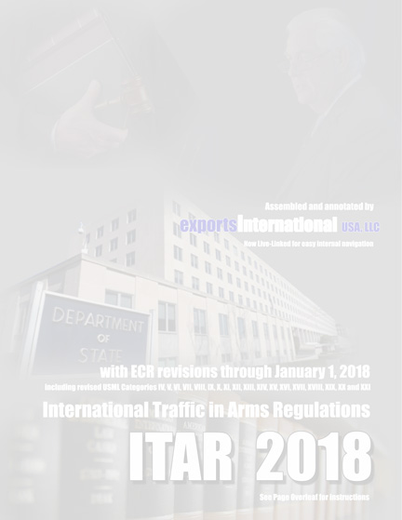
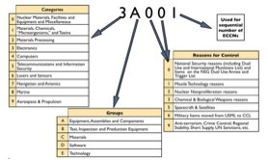
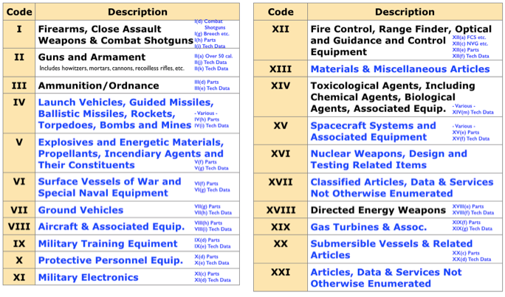
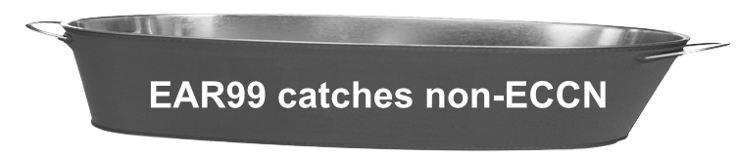
(Export Control Classification Number)
Categories: USML vs CCL
How Many Categories?
U.S. Munitions List
Commerce Control List
CCL
(EAR Jurisdiction)
USML
(ITAR Jurisdiction)
21 Categories
588 ECCNs
If no ITAR jurisdiction,
go to EAR.
Fortunately for RSG, you need to know only a few ECCN categories

Slide 75


Export License Review by USG
Simplified version assuming 600-series type items
RSG Employee Licensing
After you submit an EAR or ITAR license, here is the staffing
SNAP-R
Exporter
SNAP-R
Exporter
DOC
BIS
DOC
BIS
DOD
DTSA
DOD
DTSA
DOD
DTSA
DOE
CIA
Etc.
DOD
DTSA
DOE
CIA
Etc.
DOE
CIA
Etc.
DOE
CIA
Etc.
DTrade
Exporter
DTrade
Exporter
DOS
DDTC
DOS
DDTC
So staffing in SNAP-R vs. DTrade is very similar!

Slide 76

ECCN 9A610
Military aircraft hardware
9 A 6 1 0
Classification & SNAP-R
 | Categories
0 | Nuclear Materials, Facilities and Equipment and Miscellaneous
1 | Materials, Chemicals, “Microorganisms,” and Toxins
2 | Materials Processing
3 | Electronics
4 | Computers
5 | Telecommunications and Information Security
6 | Lasers and Sensors
7 | Navigation and Avionics
8 | Marine
9 | Aerospace & Propulsion
Used for sequential number of ECCNs
 | Reasons for Control
0 | National Security reasons (including Dual Use and International Munitions List) and Items on the NSG Dual Use Annex and Trigger List
1 | Missile Technology reasons
2 | Nuclear Nonproliferation reasons
3 | Chemical & Biological Weapons reasons
5 | Spacecraft & Satellites
6 | Military Items moved from USML to CCL
9 | Anti-terrorism, Crime Control, Regional Stability, Short Supply, UN Sanctions, etc.
 | Groups
A | Equipment, Assemblies and Components
B | Test, Inspection and Production Equipment
C | Materials
D | Software
E | Technology

Slide 77
“600 series” Example: 9A610
Military aircraft hardware
Classification & SNAP-R
9A610 Military aircraft and related commodities
License Requirements
Reason for Control: NS, RS, MT, AT, UN
Control(s) Country Chart
NS applies to entire entry NS Column 1
except 9A610.u, .v, .w,
and .y.
RS applies to entire entry RS Column 1
except 9A610.y
MT applies to 9A610.u, .v, .w MT Column 1
AT applies to entire entry AT Column 1
UN applies to entire entry See §746.1(b) for
except 9A610.y UN controls
License Exceptions
LVS: $1500
GBS: N/A
CIV: N/A
STA: (1) Paragraph (c)(1) of
(§740.20(c)(1) of the EAR) may not be used for any item in 9A610.a (i.e. “end item” military aircraft), unless determined by BIS to be eligible for License Exception STA in accordance with §740.20(g) (License Exception STA eligibility requests for “600 series” end items). (2) Paragraph (c)(2) of License Exception STA (§740.20(c)(2) of the EAR may not be used for any item in 9A610.

Slide 78
9A610 (continued)
Military aircraft hardware
.a: military aircraft
.b-.e: reserved
.f: ground control equipment
.g: aircrew life support/safety equipment
.h: parachutes, paragliders, et.
.i: controlled opening equipment or automatic piloting systems
.j: ground effect machines
.k-.s: reserved
.t: military aircraft instrument flight trainers
.u-.w: UAV-related
.x: parts, components, accessories, attachments that are “specially designed”
.y: specifically enumerated parts, components, accessories, attachments that are “specially designed”
Classification & SNAP-R

Slide 79

Country Charts re 9A610
Military Aircraft Hardware
Classification & SNAP-R
Commerce Country Chart Reasons for Control
 |  | Chemical & Biological Weapons |  |  |  | Nuclear Nonproliferation |  |  | National Security |  |  | Missile Tech |  | Regional Stability |  |  | Firearms Convention |  | Crime Control |  |  |  | Anti- Terrorism
 |  | CB 1 | CB 2 | CB 3 |  | NP 1 | NP 2 |  | NS 1 | NS 2 |  | MT 1 |  | RS 1 | RS 2 |  | FC 1 |  | CC 1 | CC 2 | CC 3 |  | AT 1 | AT 2
Canada |  | X |  |  |  |  |  |  |  |  |  |  |  |  |  |  | X
Australia ³ |  | X |  |  |  |  |  |  | X |  |  | X |  | X
Israel |  | X | X | X |  | X | X |  | X | X |  | X |  | X | X |  |  |  | X |  | X
Ireland ^{3,4} |  | X |  |  |  |  |  |  | X |  |  | X |  | X |  |  |  |  | X
Morocco |  | X | X |  |  | X |  |  | X | X |  | X |  | X | X |  |  |  | X |  | X
China |  | X | X | X |  | X |  |  | X | X |  | X |  | X | X |  |  |  | X |  | X
Bangladesh |  | X | X |  |  | X |  |  | X | X |  | X |  | X | X |  |  |  | X |  | X
3 See § 742.6(a)(3) for special provisions that apply to “military commodities” that are subject to ECCN 0A919. 4 See § 742.6(a)(2) and (4)(ii) regarding special provisions for exports and reexports of certain thermal imaging cameras to these countries.
9A610 - License Requirements
Reason for Control: NS, RS, MT, AT, UN
Control(s) Country Chart
NS applies to entire entry except 9A610.u, .v, .w, and .y. NS Column 1
RS applies to entire entry except 9A610.y RS Column 1
MT applies to 9A610.u, .v, .w MT Column 1
AT applies to entire entry AT Column 1
UN applies to entire entry except 9A610.y See §746.1(b) for UN controls
July 22, 2019
Exports International proprietary

Slide 80
Country Charts re 9E610
Technology associated with military aircraft hardware
Classification & SNAP-R
Commerce Country Chart Reasons for Control
 |  | Chemical & Biological Weapons |  |  |  | Nuclear Nonproliferation |  |  | National Security |  |  | Missile Tech |  | Regional Stability |  |  | Firearms Convention |  | Crime Control |  |  |  | Anti- Terrorism
 |  | CB 1 | CB 2 | CB 3 |  | NP 1 | NP 2 |  | NS 1 | NS 2 |  | MT 1 |  | RS 1 | RS 2 |  | FC 1 |  | CC 1 | CC 2 | CC 3 |  | AT 1 | AT 2
Canada |  | X |  |  |  |  |  |  |  |  |  |  |  |  |  |  | X
Australia ³ |  | X |  |  |  |  |  |  | X |  |  | X |  | X
Israel |  | X | X | X |  | X | X |  | X | X |  | X |  | X | X |  |  |  | X |  | X
Ireland ^{3,4} |  | X |  |  |  |  |  |  | X |  |  | X |  | X |  |  |  |  | X
Morocco |  | X | X |  |  | X |  |  | X | X |  | X |  | X | X |  |  |  | X |  | X
China |  | X | X | X |  | X |  |  | X | X |  | X |  | X | X |  |  |  | X |  | X
Bangladesh |  | X | X |  |  | X |  |  | X | X |  | X |  | X | X |  |  |  | X |  | X
3 See § 742.6(a)(3) for special provisions that apply to “military commodities” that are subject to ECCN 0A919. 4 See § 742.6(a)(2) and (4)(ii) regarding special provisions for exports and reexports of certain thermal imaging cameras to these countries.
9E610 - License Requirements
Reason for Control: NS, RS, MT, AT, UN
Control(s) Country Chart
NS applies to entire entry except 9E610.y NS Column 1
RS applies to entire entry except 9E610.y RS Column 1
MT applies to MT items in 9A610, 9B610 & 9D610 MT Column 1
AT applies to entire entry AT Column 1
UN applies to entire entry except 9E610.y See §746.1(b) for UN controls
July 22, 2019
Exports International proprietary

Slide 81

ECCN 9A991
Commercial aircraft hardware
9 A 9 9 1
Classification & SNAP-R
 | Categories
0 | Nuclear Materials, Facilities and Equipment and Miscellaneous
1 | Materials, Chemicals, “Microorganisms,” and Toxins
2 | Materials Processing
3 | Electronics
4 | Computers
5 | Telecommunications and Information Security
6 | Lasers and Sensors
7 | Navigation and Avionics
8 | Marine
9 | Aerospace & Propulsion
Used for sequential number of ECCNs
 | Reasons for Control
0 | National Security reasons (including Dual Use and International Munitions List) and Items on the NSG Dual Use Annex and Trigger List
1 | Missile Technology reasons
2 | Nuclear Nonproliferation reasons
3 | Chemical & Biological Weapons reasons
5 | Spacecraft & Satellites
6 | Military Items moved from USML to CCL
9 | Anti-terrorism, Crime Control, Regional Stability, Short Supply, UN Sanctions, etc.
 | Groups
A | Equipment, Assemblies and Components
B | Test, Inspection and Production Equipment
C | Materials
D | Software
E | Technology

Slide 82
ECCN 9A991
Commercial aircraft hardware
Classification & SNAP-R
9A991 “Aircraft”, n.e.s., and gas turbine engines not controlled by 9A001 or 9A101 and parts and components, n.e.s.
License Requirements
Reason for Control: AT, UN
Control(s) Country Chart
AT applies to entire entry AT Column 1
UN applies to 9A991.a Iraq, North Korea
and Rwanda
License Exceptions
LVS: N/A
GBS: N/A
CIV: N/A
a. Military aircraft, demilitarized (not specifically equipped or modified for military operation), as follows:
a.1 Cargo aircraft bearing “C” designations and numbered C-45 through C-118 inclusive, C-121 through C-125 inclusive, and C-131, using reciprocating engines only.
a.2 Trainer aircraft bearing “T” designations and using reciprocating engines or turboprop engines with less than 600 horsepower (s.h.p.).
a.3 Utility aircraft bearing “U” designations and using reciprocating engines only.
a.4 All liaison aircraft bearing an “L” designatn.
a.5 All observation aircraft bearing “O” designations and using reciprocating engines.
b. Civil aircraft;
c. Aero gas turbine engines, and specially designed parts therefore.
d. Aircraft parts and components, n.e.s.
e. Pressurized aircraft breathing equipment n.e.s.; and specially designed parts therefore, n.e.s.

Slide 83
Country Charts re 9A991
Commercial aircraft hardware
Classification & SNAP-R
Commerce Country Chart Reasons for Control
 |  | Chemical & Biological Weapons |  |  |  | Nuclear Nonproliferation |  |  | National Security |  |  | Missile Tech |  | Regional Stability |  |  | Firearms Convention |  | Crime Control |  |  |  | Anti- Terrorism
 |  | CB 1 | CB 2 | CB 3 |  | NP 1 | NP 2 |  | NS 1 | NS 2 |  | MT 1 |  | RS 1 | RS 2 |  | FC 1 |  | CC 1 | CC 2 | CC 3 |  | AT 1 | AT 2
Canada |  | X |  |  |  |  |  |  |  |  |  |  |  |  |  |  | X
Australia ³ |  | X |  |  |  |  |  |  | X |  |  | X |  | X
Israel |  | X | X | X |  | X | X |  | X | X |  | X |  | X | X |  |  |  | X |  | X
Ireland ^{3,4} |  | X |  |  |  |  |  |  | X |  |  | X |  | X |  |  |  |  | X
Morocco |  | X | X |  |  | X |  |  | X | X |  | X |  | X | X |  |  |  | X |  | X
China |  | X | X | X |  | X |  |  | X | X |  | X |  | X | X |  |  |  | X |  | X
Bangladesh |  | X | X |  |  | X |  |  | X | X |  | X |  | X | X |  |  |  | X |  | X
3 See § 742.6(a)(3) for special provisions that apply to “military commodities” that are subject to ECCN 0A919. 4 See § 742.6(a)(2) and (4)(ii) regarding special provisions for exports and reexports of certain thermal imaging cameras to these countries.
ECCN 9A991 controls commercial aircraft, engines, and associated parts & components
9A991 - License Requirements
Reason for Control: AT, UN
Control(s) Country Chart
AT applies to entire entry AT Column 1
UN applies to e9A991.a See §746.1(b) for UN controls
License Exceptions
LVS: N/A
GBS: N/A
CIV: N/A
July 22, 2019
Exports International proprietary

Slide 84
Country Charts re 9E991
Technology related to commercial aircraft hardware
Classification & SNAP-R
Commerce Country Chart Reasons for Control
 |  | Chemical & Biological Weapons |  |  |  | Nuclear Nonproliferation |  |  | National Security |  |  | Missile Tech |  | Regional Stability |  |  | Firearms Convention |  | Crime Control |  |  |  | Anti- Terrorism
 |  | CB 1 | CB 2 | CB 3 |  | NP 1 | NP 2 |  | NS 1 | NS 2 |  | MT 1 |  | RS 1 | RS 2 |  | FC 1 |  | CC 1 | CC 2 | CC 3 |  | AT 1 | AT 2
Canada |  | X |  |  |  |  |  |  |  |  |  |  |  |  |  |  | X
Australia ³ |  | X |  |  |  |  |  |  | X |  |  | X |  | X
Israel |  | X | X | X |  | X | X |  | X | X |  | X |  | X | X |  |  |  | X |  | X
Ireland ^{3,4} |  | X |  |  |  |  |  |  | X |  |  | X |  | X |  |  |  |  | X
Morocco |  | X | X |  |  | X |  |  | X | X |  | X |  | X | X |  |  |  | X |  | X
China |  | X | X | X |  | X |  |  | X | X |  | X |  | X | X |  |  |  | X |  | X
Bangladesh |  | X | X |  |  | X |  |  | X | X |  | X |  | X | X |  |  |  | X |  | X
3 See § 742.6(a)(3) for special provisions that apply to “military commodities” that are subject to ECCN 0A919. 4 See § 742.6(a)(2) and (4)(ii) regarding special provisions for exports and reexports of certain thermal imaging cameras to these countries.
ECCN 9E991 controls tech data re commercial aircraft development or use
9E991 - License Requirements
Reason for Control: AT
Control(s) Country Chart
AT applies to entire entry AT Column 1
License Exceptions
CIV: N/A
TSR: N/A
July 22, 2019
Exports International proprietary

Slide 85
Agreements
TAA / MLA / WDA
When do you need them?

Slide 86
ITAR-Controlled Data Exports
ITAR tech-data exports
“FC” = “Foreign Consignee” "OEM" = "Original Equipment Manufacturer"
Disclosure/Export | Appropriate Authorization
From FC to RSG | NLR for importing defense articles to US
From RSG to L-3 | NLR for US Person to US Person
From RSG to L-3 with Abhilash | NLR + DSP-5 050688310 employee license
From L-3 to RSG | NLR for importing defense articles to US
From L-3 to Boeing | NLR for US Person to US Person
From Boeing to L-3 | NLR for US Person to US Person
From FC to L-3 | NLR for importing defense articles to US
From L-3 to FC | Requires TAA, or Tech-data DSP-5, or the “Build-to-Print” ITAR exemption §125.4(c)(1)
From RSG to FC | Requires TAA, or Tech-data DSP-5, or the “Build-to-Print” ITAR exemption §125.4(c)(1)

Slide 87
What are Agreements?
Agreements: TAA/MLA/WDA
These are “mega-export licenses” that authorize the export of controlled technical data, including source code, and/or the license production abroad of defense articles. Can also set up overseas warehousing operations.
Agreements are not form-licenses, like DSP-5s for example, but form-licenses typically are approved in furtherance of agreements.
Agreements look like contracts, with “WHEREAS...” and “NOW THEREFORE...” type language.

Slide 88
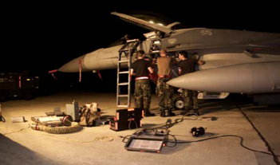
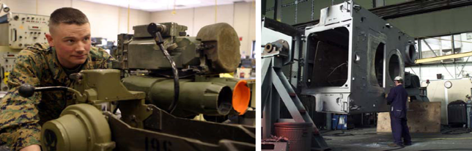
Levels of DoD Maintenance
Maintenance levels at a glance
Agreements: TAA/MLA/WDA
Organizational
Intermediate
Depot
“O-Level” or “Level I”
“Level II - Level III - Level IV”
No License Required - per ITAR § 124.2
Agreement (TAA, MLA or WDA) required to export these capabilities
The “basic O&M exemption” at §§ 124.2(a) and 125.4(b)(5) specifically says: “This does not include training in intermediate and depot level maintenance.”
So training for Levels II and above requires an Agreement. The maintenance manuals for Levels II and above require a DSP-5 or Agreement.
But NATO, Australia, Japan & Sweden enjoy a broad exception to the limits of the O&M exemption, at § 124.2(c).
Increasing volume of maintenance
More frequent tasks that require
less facilitization/skills
Less frequent tasks that require
more facilitization/skills
Increasing complexity of maintenance

Slide 89
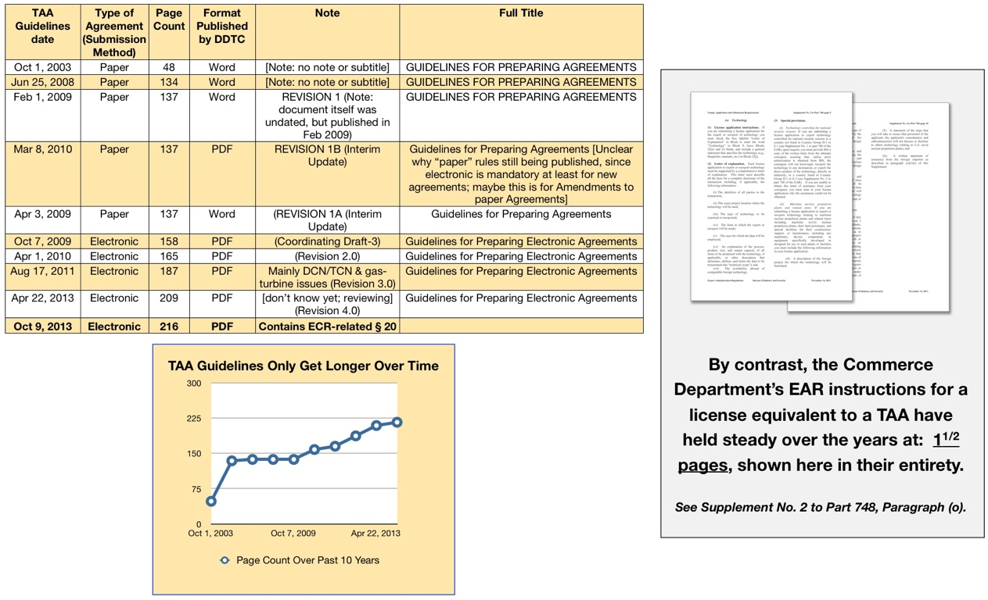
TAA Guidelines Keep Growing
Agreements: TAA/MLA/WDA
(but not the EAR equivalent)
(much simpler than ITAR rules)

Slide 90
Components of Agreements
Agreements: TAA/MLA/WDA
The agreement itself, the TAA, MLA or WDA
The transmittal letter, or TL, a stylized cover letter, where one tells the back-story, provides additional assurances and details not in the agreement.
The TL includes a value table, with dollar limits on proposed exports of hardware, tech data, software and the performance of defense services
Support documentation, including as needed: product info, SOW, DSP-83, end-use/r statement
Often it’s best to put most of this in the TL, to keep the agreement clean. The TL is Normally sent only to DDTC, not the other parties to the agreement.

Slide 91
Types of Agreements?
Agreements: TAA/MLA/WDA
TAA - Technical Assistance Agreement
When technical data are transferred to, or defense services are performed on behalf of, a foreign entity.
WDA - Warehouse and Distribution Agreement
to establish a warehouse or distribution point abroad for defense articles to be exported from the U.S. for subsequent distribution in an approved sales territory.
MLA - Manufacturing License Agreement
When granting manufacturing rights to a foreign entity and manufacturing know-how is also conveyed. Also required to permit overseas depot-level maintenance by foreign entities.

Slide 92
Submit via “Vehicle DSP-5”
Agreements: TAA/MLA/WDA
D-Trade has no way to submit a TAA, so they “hijacked” the DSP-5 form
The “Vehicle DSP-5” is completely remapped, so actual labels on the form are virtually meaningless.
Must use a separately provided key to fill in the DSP-5
In this way, one fills in the form, and “stuffs the turkey” with the TAA/MLA/WDA, its TL and all support documentation
Track the progress of the agreement using the DSP-5 number
The approved agreement comes via the DSP-5
The approval letter - and its provisos do, too
You must keep track of two case numbers :-)

Slide 93
DN/TCN Employees
(State/DDTC/ITAR jurisdiction only)
DN/TCN Employees
DN/TCNs must be accounted for -- sometimes personally named -- in a TAA or MLA application for approval to transfer “controlled information and/or hardware
“Dual-National” is national of Licensee + another country(ies)
“Third-Country National” is not a national of Licensee’s country
For DDTC “nationality” equates to “passport”
Original place-of-birth also considered, especially if from a § 126.1 country
DN/TCN procedures come in three main flavors: Options 1, 2 & 3
If a § 126.1 country is involved, then individual employee is named in the TAA/MLA application and voluminous personal information must be included
TCN employees of US firms use a “DSP-5” license process
DDTC has 3 different NDA forms, depending on situation
“Contract employees” are usually treated as Normal employees

Slide 94
DN/TCN Approvals - Option 2
(State/DDTC/ITAR jurisdiction only)
** “TAA” should be considered shorthand for all forms of ITAR “Agreements” including MLA, etc.
DN/TCN Employees
DN/TCN approvals by DDTC per TAA “Option 2” procedures **
Foreign Licensee Employee Type (also applies to sublicensees) | DDTC Decision Factors | Disclosure(s) in TAA application | Comments
DN/TCN whose nationality and/or birth nation is non-§126.1 per Agreement Guidelines 3.5.2.a | Current/primary nationality | Current nationality(ies) only | Routine §124.8(5) Option 2 procedure Add (by nationality only) to Block 18 of DSP-5
TCN whose nationality and/or birth nation is §126.1(a) per Agreement Guidelines 3.5.2.d(1) | Primary nationality and birth nation. Generally disapproved | Individual name and supporting docs package | Requires special §124.8(5) TCN statement in TAA Add (by name) to Block 18 of DSP-5
DN whose nationality and/or birth nation is §126.1(a) per Agreement Guidelines 3.5.2.d(2) | Primary nationality and birth nation. May be approved if primary nationality is a non-126.1 country | Individual name and supporting docs package | Requires special §124.8(5) DN statement in TAA Add (by name) to Block 18 of DSP-5
TCN whose nationality and/or birth nation is non-§126.1(a) per Agreement Guidelines 3.5.2.d(3) | Current nationality | Current nationality only | Requires special §124.8(5) TCN statement in TAA Add (by nationality only) to Block 18 of DSP-5
DN whose nationality and/or birth nation is non-§126.1(a) per Agreement Guidelines 3.5.2.d(4) | Primary nationality and birth nation. May be approved if primary nationality is a non-126.1 country | Individual name and supporting docs package | Requires special §124.8(5) DN statement in TAA Add (by name) to Block 18 of DSP-5

Slide 95
The DN/TCN Rules re NDA
(State/DDTC/ITAR jurisdiction only)
** “U.S.exporters are required to determine the nationality(ies) of all individuals that might have access to defense articles or
defense services and to disclose that information in their requests for export authorizations.” -- DDTC Agreement Guidelines 4/22/2013
DN/TCN Employees
DN/TCN Employees and the special-format Nondisclosure Agreement
 | Employee signs NDA? | Disposition of NDA (Retain for > 5 years after expiration of the TAA) | Approval how?
Option 1 no classified | Yes | Licensee retains the NDA (and “surveillance” info) N.B.1: Employees with a national security clearance need not sign an NDA N.B.2: For others,Licensee must conduct same employee “surveillance” as for Option 3 | via the Agreement
Option 2 per 124.8(5) | Yes | Licensee sends the NDA to U.S. Agreement-holder N.B.: Classified info is okay, with certain special verbiage in the Agreement | via the Agreement
Option 2 per 124.16 | No (if unclassified) | N/A [Applies only to NATO/EU+4 employees] N.B.1: 124.16 only applies if the Licensee is domiciled in NATO/EU+4 country N.B.2: If data/hardware is classified, procedure reverts to 124.8(5) with an NDA | via the Agreement
Option 3 DDTC says to use only as a “last resort” | Yes | Licensee sends the NDA to DDTC In a General Correspondence to DDTC, Licensee includes individual’s full name, nationality, date/place of birth, passport, resume, detailed job description, justification for why this employee is needed + report of “substantive contact” with §126.1 countries | via a GC from Licensee to DDTC
126.1 DN uses Option 2 | Yes | DN with § 126.1 origin are possible if “primary nationality” is non-126.1 Individual DN/TCN must be identified by name & country(ies) in the Agreement, and include the same background investigation documentation info as for Option 3 | via the Agreement
126.1 TCN uses Option 2 | Yes | Presumption of denial for TCN from § 126.1 countries Individual DN/TCN must be identified by name & country(ies) in the Agreement, and include the same background investigation documentation info as for Option 3 | via the Agreement
Sub- Licensees | No | Sublicensee sends the NDA via Licensee to TAA-holder Sublicensees (not their individual DN/TCN employees) must sign a special NDA that includes all the tech data nontransfer restrictions that are also in the TAA/MLA - before any “covered” disclosures | via the Agreement
Misc. |  | There are special DN/TCN exemptions for Canada, Australia & Holland
Employed by US firm | Yes | Employer retains the NDA • Not for “US Person” employees • Another unique NDA format • No TCN from 126.1 | via Employee DSP-5
Guidelines 3.5.1.d
Guidelines 3.5.2.a(4)
Guidelines 3.5.2.b
Guidelines 3.5.3 is vague
Guidelines 3.5.2.d(2)
Guidelines 3.5.2.d(1)
Guidelines 3.2(b)(4)
Employee Licensing Guidelines

Slide 96
Licensing Contract Employees
(State/DDTC/ITAR jurisdiction only)
Contract Employees
From the perspective of US license applicants
Under a TAA, etc., see Agreement Guidelines § 3.9
If not under an Agreement, just center column applies
These rules were just recently clarified
In short: “contract employees” are treated as “employees”
Licensing Scenarios for Contract Employees under TAA/MLA
 | Employee DSP-5 Required? | Amend TAA/MLA?
Via a Foreign Staffing Firm | No | Yes (All parties must sign)
Via a US-Person Staffing Firm | Yes (Either you, or the US Staffing Firm if DDTC-registered) | No
You Directly Hire a Foreign Contract Employee | Yes | No

Slide 97
Hardware via “Form Licenses”
Agreements: TAA/MLA/WDA
The TAA etc. approves the export of data only; cite § 125.4(b)(2) exemption on package when you send data; keep records.
Hardware exported under this approval still needs DSP-5 etc.
The form-license follows a different format that is either:
“In Furtherance Of” the agreement, or
“In Support Of” the agreement
It is still possible to export defense articles like those covered by the agreement, as a “stand-alone” DSP-5 etc.
Rules are a bit tricky. If done wrong, could create violation
The point is not to seem to be “getting around” value limits

Slide 98
ITAR-Controlled Data Exports - Pop Quiz
All exports to foreign-persons must have a written authorization

Slide 99
ITAR Controlled-Data Exports
ITAR tech-data exports
In this test, “FC” = “Foreign Consignee”.
Answer choices: TAA, NLR, ITAR Exemption, and/or DSP-5
Note: If you say “DSP-5”, specify what kind
Disclosure/Export | Appropriate Authorization
From FC to RSG | NLR for importing defense articles to US
From RSG to L-3 | NLR for US Person to US Person
From RSG to L-3 with Abhilash | NLR + DSP-5 050688310 employee license
From L-3 to RSG | NLR for importing defense articles to US
From L-3 to Boeing | NLR for US Person to US Person
From Boeing to L-3 | NLR for US Person to US Person
From FC to L-3 | NLR for importing defense articles to US
From L-3 to FC | Requires TAA, or Tech-data DSP-5, or the “Build-to-Print” ITAR exemption §125.4(c)(1)
From RSG to FC | Requires TAA, or Tech-data DSP-5, or the “Build-to-Print” ITAR exemption §125.4(c)(1)

Slide 100
ITAR/EAR License Exemptions/Exceptions

Slide 101
ITAR License Exemptions
Note: Most of these are for tech-data, not hardware
ITAR tech-data exports
Type of Transaction | ITAR Exemption
Temporary import-related | § 123.4
Low-value shipments | § 123.16(b)(2)
Temp for exhibition or demo | § 123.16(b)(5)
Temp to affiliate/subsidiary | § 123.16(b)(9)
Items transiting the U.S. | § 123.19
Exported per USG Agency directive | § 125.4(b)(1)
Per contract with USG Agency | § 125.4(b)(3)
Copies of tech data previously authorized to same recipient | § 125.4(b)(4)
Basic O&M exemption/exception | § 125.4(b)(5)
US university to certain employees | § 125.4(b)(10)
Build-to-Print package to NATO+3 if asked officially by DoD | § 125.4(c)(1)
Shipments by or for USG Agencies | § 126.4
Support FMS or other USG efforts | § 126.6(a)

Slide 102
Exemptions vs. Exceptions
ITAR vs EAR
Type of Transaction | ITAR Exemption | EAR Exception
Temporary import-related | § 123.4 | RPL § 740.10; TMP § 740.9(B)(2) & (B)(4)
Low-value shipments | § 123.16(b)(2) | LVS § 740.3
Temp for exhibition or demo | § 123.16(b)(5) | TMP § 740.9(a)(5)
Temp to affiliate/subsidiary | § 123.16(b)(9) | TMP § 740.9(a)(10)
Temp for body armor/chemsuit | § 123.17(f)-(i) | TMP § 740.9(a)(11); BAG § 740.14(h)(2)
Items transiting the U.S. | § 123.19 | TMP § 740.9(b)(1)
Exported per USG Agency directive | § 125.4(b)(1) | GOV § 740.11(b)(2)
Per contract with USG Agency | § 125.4(b)(3) | GOV § 740.11(b)(2)
Copies of tech data previously authorized to same recipient | § 125.4(b)(4) | TSU § 740.13(g)
Basic O&M exemption/exception | § 124.2(a) § 125.4(b)(5) | TSU § 740.13(a)
US university to certain employees | § 125.4(b)(10) | TSU § 740.13(f)
Shipments by or for USG Agencies | § 126.4 | GOV § 740.11(b)(2)
Support FMS or other USG efforts | § 126.6(a) | GOV § 740.11(b)(2)(iii)

Slide 103
“Canadian Exemptions” under
the ITAR & EAR
Exemptions and Exceptions
Go to ITAR § 126.5 to see the famous “Canadian Exemptions”
But read carefully: it contains quadruple negatives
Temp import to U.S. from any country but Canada for repair/replacement — use ITAR § 123.4(a)(1)
Except importing from Canada — use ITAR § 126.5(a)
Permanent export to Canada is under ITAR § 126.5(b)
But first clear the many exclusions in § 126 Suppl. N^{o.}1
EAR license “exception” - none per se, but see Country Chart for Canada for the equivalent to ITAR 126.5

Slide 104
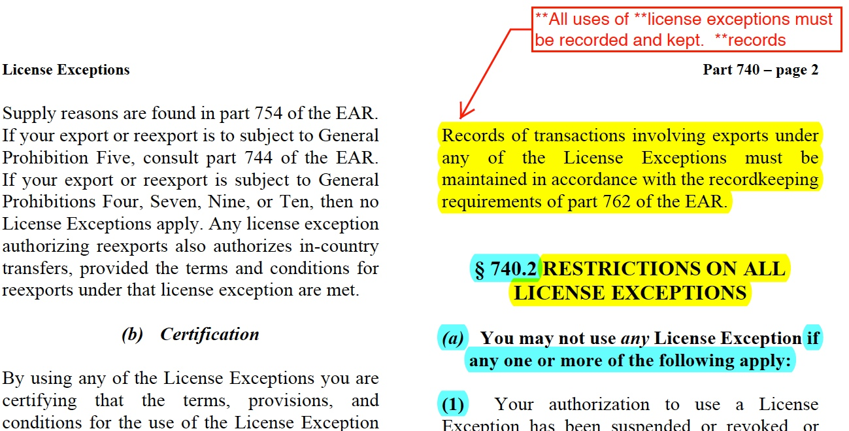
ITAR “Canadian Exemptions”
EAR License Exceptions
But for all ITAR exemptions and EAR exceptions must be documented, and file kept for at least 5 years. Here is the EAR requirement.

Slide 105
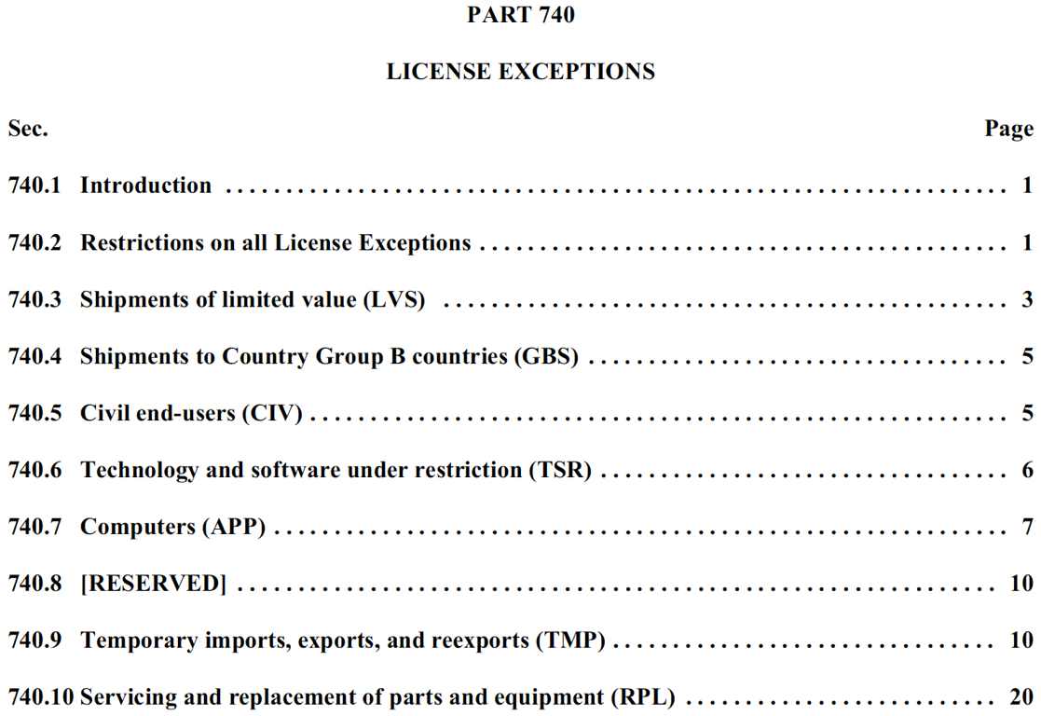
License Exceptions
EAR License Exceptions
“TMP” is an especially useful exception, but with important limits

Slide 106
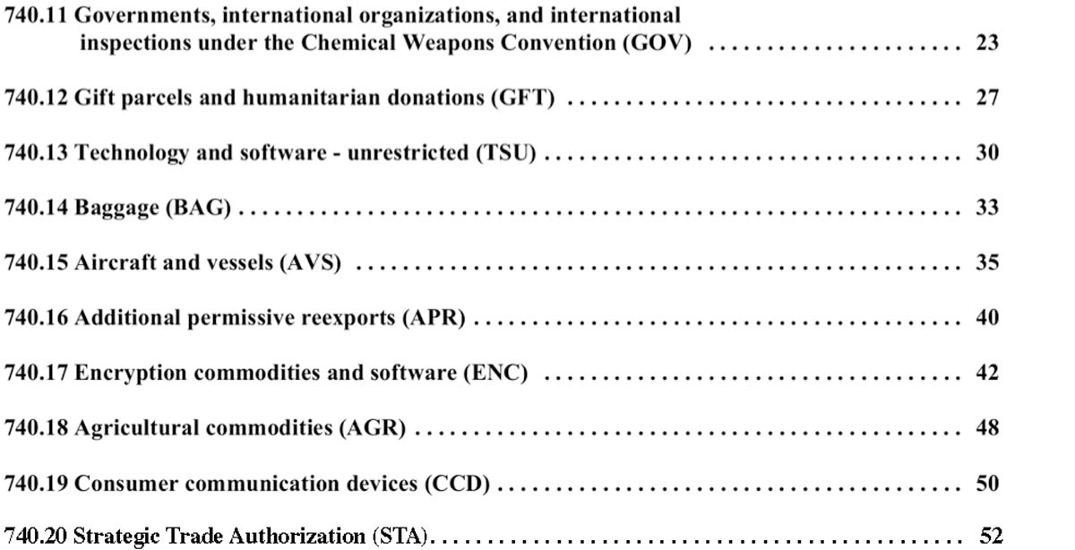
License Exceptions (Cont.)
Classification & RSGP-R

Slide 107
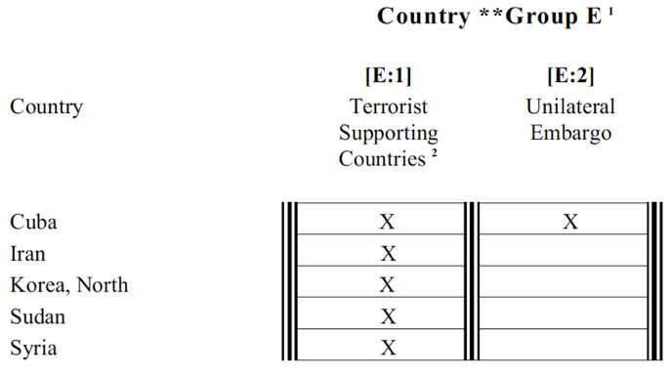
License Exception “TMP”
EAR License Exceptions
Restrictions include: No “E:2 Countries or Sudan”

Slide 108
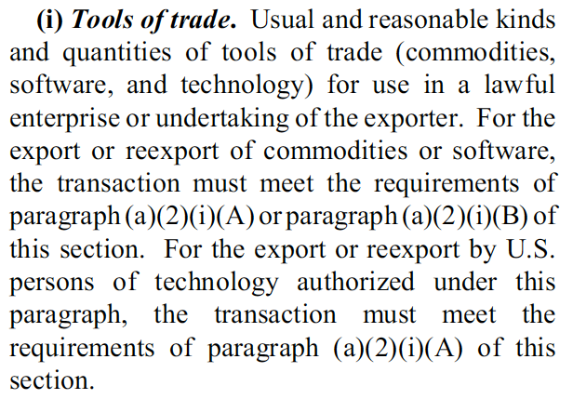
License Exception “TMP”
EAR License Exceptions
Using TMP may ease “sanitized laptop” rules for RSG

Slide 109
License Exception “TMP”
EAR License Exceptions
Eligible tools of trade:
Eligible tools of trade may include, but are not limited to, equipment and software as is necessary to commission or service items, provided that the equipment or software is appropriate for this purpose and that all items to be commissioned or serviced are of foreign origin, or if subject to the EAR, have been lawfully exported or reexported.

Slide 110
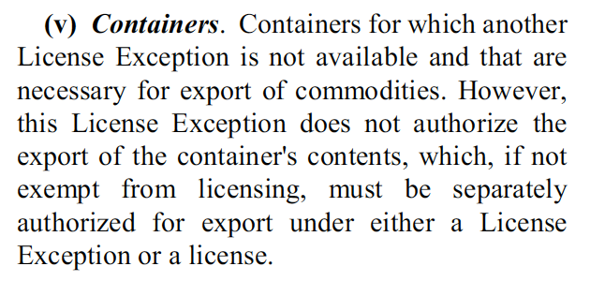
License Exception “TMP”
EAR License Exceptions
Specialized shipping containers included under TMP

Slide 111
License Exception STA

Slide 112
License Exception STA
Applies to all items subject to the EAR
EAR License Exceptions
Requirements for all items subject to the EAR:
ECCN must specifically authorize STA
All reasons for control that apply to the transactions must be authorized to used STA
NS, CB, NP, RS, CC, SI: Country Group A:5 (§ 740.20(c)(1))
Argentina, Australia, Austria, Belgium, Bulgaria, Canada, Croatia, Czech Republic, Denmark, Estonia, Finland, France, Germany, Greece, Hungary, Iceland, Ireland, Italy, Japan, Latvia, Lithuania, Luxembourg, Netherlands, New Zealand, Norway, Poland, Portugal, Romania, Slovakia, Slovenia, South Korea, Spain, Sweden, Switzerland, Turkey, and United Kingdom
NS only: Country Group A:6 (§ 740.20©(2)) [NOT available for 600-series items]
Albania, Hong Kong, India, Israel, Malta, Singapore, South Africa, & Taiwan

Slide 113
License Exceptions 600-series
600-series items can only use 7 EAR license exceptions
Commerce Dep’t EAR
LVS § 740.3 | Low value shipments ($1500 for most 600 series commodity ECCNs)
TMP § 740.9 | Temporary exports (tools of trade, exhibition/demonstration, certain exports to U.S. person’s facility abroad); certain returns of items temporarily in the U.S.; temporary exports of personal protective equipment
RPL § 740.10 | One-for-one replacement parts/components; return repaired or replaced items
GOV § 740.11 .11(b) .11(c) | Personnel and agencies of USG, including contractor support personnel; certain shipments for or on behalf of USG and DoD-directed shipments; cooperating governments; NATO agencies and Cooperating Governments
TSU § 740.13 .13(a) .13(b) .13(f) .13(g) | Operation technology/software; sales technology; technology/source code in the U.S. to bona fide, full time regular employees of U.S. universities; copies of technology previously authorized
BAG § 740.14 | Certain personal protective equipment with U.S. person’s baggage or effects
STA § 740.20 | 600 series for Country Group A:5, and can be used for “technology” in a manner similar to TAAs on the ITAR side
Source: EAR - § 736.2

Slide 114
License Exception STA
Responsibilities of the parties involved
Commerce Dep’t EAR
 | Exporter/Reexporter | Consignee
1 | Provide ECCN(s) to Consignee | -
2 | - | Provide Prior Consignee Statement to Exporter/Reexporter
3 | Obtain Prior Consignee Statement | -
4 | Notify consignee that shipment (or specific items within a shipment) is (are) under STA | -
5 | Keep records showing which shipments belong to each consignee statement | Maintain Consignee Statement and records pertaining to subsequent reexport or transfer
PCS - Five Points
Aware that items are to be shipped under STA Been informed of ECCN by the “prior consignee” No subsequent License Exception APR (a) or (b) shipments Agrees not to ship or transfer in violation of EAR Agrees to provide documents to USG upon request

Slide 115
“STA” Exception re 600-series
EAR License Exceptions
Cannot be used if an ECCN identifies it as ineligible for STA
Can be used to export, reexport or transfer to “A5” countries, if the ultimate end-user is the armed forces, or similar agency
May may not be used to export, reexport, or transfer (in-country) end items described in ECCN 9A610.a until after BIS has approved their export under STA under the procedures set out in § 740.20(g)
600-series items controlled for “MT” cannot use STA, per § 740.2(a)(13). This applies to 9A610.u, .v, and .w.
Limitations on use of STA that are specific to 600-series:

Slide 116
Problems in using STA
EAR License Exception STA
You must secure a signed copy of the Prior Consignee Statement from all parties before you can export any goods at all under STA. It is a violation under the EAR to not have all these signed Prior Consignee Statements in place before any exports.
If any party is added, then you must get new Prior Consignee Statement first, before exporting.
All signers of that Prior Consignee Statement are subject to USG compliance visits re STA.
Not very many exporters are using STA even if they are eligible -- I understand that some U.S. OEMs are staying away from using STA, for example -- because of these complexities and added risks. I believe in the first year of STA only 6 exports occurred under it.
Avoiding the use of STA is understandable especially since it is so easy to use the "blanket license" approach (where that fits).
Support documentation requirements are also easiest when using BIS blanket license.

Slide 117
Required Support Documents
Continue a TAA vs STA
Under the ECR rules, Commerce licenses are often easier than either State licenses or License Exception STA
Regarding Hardware | DOS DSP-5 | Commerce BIS | License Exception STA
Before applying for license (or using an exception) | P.O. (or LOI) End-Use Statement End-User Statement | Nothing | Formal “Letter of Assurance” from all Parties
If “In Furtherance Of” a TAA or MLA | Letter of Explanation signed by the TAA-holder | N/A | N/A
* Note: In all cases, an exporter must have the basic end-use/end-user information before exporting. This is true even of EAR99 items, since there are still prohibited end-uses, end-users, and destinations.

Slide 118
Country Group A5
The “Most Favored Nations” list for License Exception STA
EAR License Exceptions
Argentina
Australia
Austria *
Belgium
Bulgaria
Canada
Croatia
Czech Republic
Denmark
Estonia
Finland
France
Germany
Greece
Hungary
Iceland
Ireland *
Italy
Japan
South Korea *
Latvia
Lithuania
Luxembourg
Netherlands
New Zealand *
Norway
Poland
Portugal
Romania
Slovakia
Slovenia
Spain
Sweden *
Switzerland *
Turkey
United Kingdom
* Cooperating Country

Slide 119
“STA” Exception re 600-series
EAR License Exception STA
Exporter/reexporter/transferor must furnish the ECCN(s) to consignees
Exporter/reexporter/transferor must sign a formal Prior Consignee Statement (“PCS”), and secure same from all entities in the chain of title before the export can begin. For example:
Chain of Title Transfer
Purchase Order
Purchase Order
Foreign
Intermediate
Consignee
Purchase Order
Foreign
End-User
Foreign
Consignee
US Exporter
Title Transfer
Title Transfer
Title Transfer
Each PCS contains nontransfer assurances similar to BIS-711 or DSP-83. Also agrees to permit a U.S. Government end-use check with respect to confirm compliance.

Slide 120
Civil & Criminal Penalties

Slide 121


Main Export Regulations
ITAR & EAR - Major updates Oct 2013, Jan 2014, Mar 2014 & more …
Export Regulations
International Traffic in Arms
Regulations (ITAR)
Export Administration
Regulations (EAR)

Slide 122
Revised Export Categories
Rewritten USML & CCL
Most are now published and final
All revised USML categories have corresponding changes to CCL
USML (ITAR) & CCL (EAR) Categories as of May 4, 2018:
USML | CCL |  | Description | Effective Date
I | 0Y601 |  | Firearms | TBD
II | 0Y602 |  | Artillery | TBD
III | 0Y603 |  | Ammunition | TBD
IV | 9Y604 | 0Y604 | Launch Vehicles/Missiles | Jul 1, 2014
V | 1C608 - 1E608 |  | Explosives/Propellants | Jul 1, 2014
VI | 8Y609 | 8Y620 | Vessels of War | Jan 6, 2014
VII | 0Y606 |  | Tanks/Military Vehicles | Jan 6, 2014
VIII | 9Y610 7Y610 (Avionics) |  | Aircraft and Associated Equipment | Oct 15, 2013
IX | 0Y614 |  | Training Equipment | Jul 1, 2014
X | 1Y613 |  | Personal Protective Equipment | Jul 1, 2014

Slide 123
Revised Export Categories
Rewritten USML & CCL
XI | 3Y611 | 9Y620 | Electronics (“Interim Final Rule”) | Dec 30, 2014
XII | 6Y615 - 7Y611 |  | Fire Control/NV | TBD - 2nd draft issued
XIII | 0Y617 - | 6Y617 - 8Y617 | Miscellaneous | Jan 6, 2014
XIV | 1Y607 |  | Toxicological Agents | TBD
XV | 9Y515 | 3Y611 - 9Y604 | Spacecraft/Satellites | Jul 1, 2014 (Radiation-hardened) | Nov 10, 2014 (All others)
XVI | 0B618 - 0A607 |  | Nuclear Weapons | Jul 1, 2014
XVII |  |  | Classified Articles, Data, Services | Oct 15, 2013
XVIII | 6Y619 |  | Directed Energy Weapons | Dec 31, 2016
XIX | 9Y619 |  | Gas Turbine Engines | Oct 15, 2013
XX | 8Y620 |  | Submersible Vessels | Jan 6, 2014
XXI |  |  | Items Not Otherwise Enumerated | Oct 15, 2013
ITAR §120.41 | EAR Part 772.1 |  | “Specially Designed” Definition | Oct 15, 2013
Effective in current ITAR/EAR
Not yet rewritten for ECR
Published as a Draft Rule

Slide 124
DDTC License Processing Times
D-Trade 2 & DSP-5
Month and Year | Aug 2017 | Sep 2017 | Oct 2017 | Nov 2017 | Dec 2017 | Jan 2017 | Feb 2017 | Mar 2017 | Apr 2017 | May 2017 | Jun 2017 | Jul 2017 | Aug 2017
Cases Received | 3,548 | 3,335 | 3,112 | 3,126 | 3,234 | 2,792 | 3,083 | 3,716 | 3,215 | 3,284 | 3,456 | 2,891 | 3,563
Cases Closed | 3,844 | 3,382 | 3,148 | 3,192 | 3,354 | 2,911 | 3,157 | 3,632 | 3,401 | 3,269 | 3,346 | 2,830 | 3,575
Cases Open at End of Month | 2,963 | 2,970 | 2,974 | 3,049 | 2,781 | 2,832 | 2,828 | 2,821 | 2,768 | 2,815 | 2.908 | 3,001 | 3,010
Average Processing Time (Calendar Days) | 29 | 27 | 29 | 29 | 29 | 32 | 26 | 27 | 25 | 29 | 25 | 29 | 29
Double the processing time, compared to 2008
Month and Year | Mar 2008 | Apr 2008 | May 2008 | Jun 2008 | Jul 2008 | Aug 2008 | Sep 2008 | Oct 2008 | Nov 2008 | Dec 2008 | Jan 2009 | Feb 2009 | Mar 2009
Average Processing Time (Calendar Days) | 15 | 15 | 15 | 15 | 17 | 16 | 16 | 16 | 16 | 16 | 17 | 15 | 15

Slide 125
Civil & Criminal Penalties (ITAR)
Department of State / Directorate of Defense Trade Controls (DoS/DDTC)
Note: The Federal Civil Penalties Inflation Adjustment Act of 2015, required Federal Agencies to make a one time “catch-up” adjustment to their Civil Monetary Penalties in order to account for inflation, followed by annual inflation adjustments.
Export-Violation Penalties
International Traffic in Arms Regulations (U.S. Department of State)
 | Fine | Imprisonment
Criminal Sanctions
Fines/Imprisonment | Up to $1,111,908 for each violation | 20 years’ imprisonment
Other Measures | Debarment from export activities; mandatory audits by officially designated auditors
Civil (Administrative) Sanctions
Fines | Up to $1,111,908 for each violation | N/A
Other Measures | Debarment from export activities; mandatory audits by officially designated auditors
Possible additional sanctions for each violation include the denial of export privileges, and/or the seizure or forfeiture of goods.

Slide 126
Civil & Criminal Penalties (EAR)
Department of Commerce / Bureau of Industry & Security (DoC/BIS)
Note: The Federal Civil Penalties Inflation Adjustment Act of 2015, required Federal Agencies to make a one time “catch-up” adjustment to their Civil Monetary Penalties in order to account for inflation, followed by annual inflation adjustments.
Export-Violation Penalties
Export Administration Regulations (U.S. Department of Commerce)
 | Fine | Imprisonment
Willful Violations § 764.3(b)(2)(i)
Company | The greater of $1 million or 5 times the value of the exports for each violation
Individual | Up to $250,000 for each violation | Up to 10 years for each violation
Knowing Violations § 764.3(b)(2) and (b)(2)(ii)
Company | Up to $50,000 or 5 times the value of the exports for each violation
Individual | Up to $50,000* or 5 times the value of the exports for violation (*If knowing military diversion, up to $250,000) | Up to 5 years for each violation
Civil (Administrative) Sanctions: Up to $12,000 for each violation. If the violations involve items controlled for national security reasons, the fine is ten times greater or up to $120,000 for each violation.
Possible additional sanctions for each violation include the denial of export privileges, and/or the exclusion from practice, and/or seizure or forfeiture of goods. DOS & DOD may cross-debar after these violations.

Slide 127
Employee Licenses at
RSG

Slide 128
Employee Licensing at RSG
RSG Employee Licensing
All "exports" of "controlled items" require licenses or documented exceptions
Disclosing or discussing EAR-controlled data with a "foreign person" (= "non-U.S. person") counts as an export - even if it happens in this conference room
Note: The EAR calls this a "deemed export"
Without such licensing, RSG foreign-person employees would have to be sequestered from contact with tech data
But, confusion about exactly what employee licenses really allow can cause violations

Slide 129
Why are they important?
RSG Employee Licensing
Accidental exports/disclosures of controlled data by foreign persons are a major concern for the USG
Faulty employee-license procedures are "low-hanging fruit" when a USG compliance team visits
As with other export issues, "if you don’t have it in writing, it doesn’t exist"
A systematic approach to export logs is needed
We are creating this system for RSG to follow
Recordkeeping is key in export-compliance, but overly complex systems are doomed to failure
We are still working with DOC Policy to simplify

Slide 130


Common RSG / SC structure
Transaction structures typical for RSG/SC hardware sales
RSG Employee Licensing
Chain of Title Transfer - Version A
Contract or
PO or LOI
FC
Contract or
PO or LOI
US Exporter
Morocco
Reduce to the simplest possible
licensing structure
Title Transfer
Title Transfer
Start by deleting almost all parties …
and most destinations …
Chain of Title Transfer - Version B
Contract or
PO or LOI
Other
FC
etc.
Contract or
PO or LOI
FC
Contract or
PO or LOI
US Exporter
Morocco
Title Transfer
Title Transfer
Title Transfer
Chain of Possession of RSG Exports
Move
Other
FC
etc.
Move
FC
Move
Foreign FF
Export
FF
(US)
Move
U.S. Domestic
Sale/Transfer
L-3
Aviall
or HW
Morocco
RSG
USPPI
Exporter-of-Record
Chain of Possession of L-3 Exports Directly to Shintoa
Move
Other
FC
etc.
Move
FC
Move
Foreign FF
Export
FF
(US)
Move
L-3
Morocco
RSG
RSG
USPPI
Exporter-of-Record

Slide 131
Change to employee license
employee
RSG Employee Licensing
Chain of Title Transfer - Version A
Contract or
PO or LOI
FC
Contract or
PO or LOI
US Exporter
Morocco
Reduce to the simplest possible
licensing structure
Title Transfer
Title Transfer
Start by deleting almost all parties …
and most destinations …
Chain of Title Transfer - Version B
Contract or
PO or LOI
Other
FC
etc.
Contract or
PO or LOI
FC
Contract or
PO or LOI
US Exporter
Morocco
Title Transfer
Title Transfer
Title Transfer
Chain of Possession of RSG Exports
Move
Other
FC
etc.
Move
FC
Move
Foreign FF
Export
FF
(US)
Move
U.S. Domestic
Sale/Transfer
Morocco
RSG
L-3
USPPI
Exporter-of-Record
Chain of Possession of L-3 Exports Directly to Shintoa
Move
Other
FC
etc.
Move
FC
Move
Foreign FF
Export
FF
(US)
Move
L-3
Morocco
RSG
RSG
USPPI
Exporter-of-Record

Slide 132
RSG employee license structure
RSG Employee Licensing
Employee licenses are completely different from hardware licenses and from TAAs.
Hardware licenses & TAAs can have many parties.
There are only 2 parties to an employee license:
The employer
The employee
There is only one purpose to an employee license: so that the U.S. employer can disclose controlled tech-data to the foreign-person employee.
Abhilash
(India)
Export
RSG
USPPI
Exporter-of-Record

Slide 133
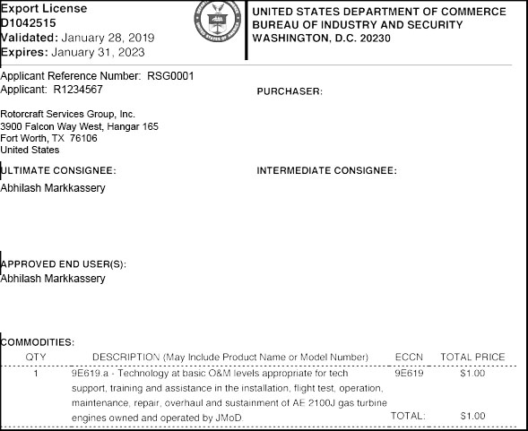
What employee licenses allow
Abhilash Markkassery as an example, but also applies to all foreign employees at RSG
RSG Employee Licensing
Abhilash has an employee license for, say, 9E619 (engines).
Only 2 parties:
RSG
Abhilash
License allows RSG to disclose 9E619.a tech-data to Abhilash, but only for the AE 2100J.
Does not authorize Abhilash to export any controlled info to anyone.
No "Purchaser"
No "Intermediate Consignee"

Slide 134
How can Abhilash send any docs or attend L-3 technical meetings?
RSG Employee Licensing
As a "person," Abhilash will never be able to export or disclose controlled tech-data to anyone!
Abhilash
For example, L-3 can only disclose controlled data to Abhilash — if L-3 has an approved license listing the ultimate consignee as “Abhilash Markkassery."
But Abhilash will always attend technical meetings at L-3 as an employee of RSG.
So what feels like this to Abhilash:
John Doe
(L-3)
is really this:
.
Export
L-3
No
Export
Abhilash
RSG
Likewise, what feels like this to Abhilash:
Abhilash
Export
Morocco Rep
is really this:
.
RSG
Export
Morocco Rep

Slide 135
Export Compliance
Some overarching advice

Slide 136
Foreign entities’ advice re
ITAR/EAR policy or procedure
Solving Export Problems
Foreign opinions about USML and CCL export USML and CCL classifications should be taken with a grain of salt.
Same skepticism should greet foreign views on USG export procedures.

Slide 137
Transactional Approach
to Export Compliance
Solving Export Problems
Do not assume that all is well just because you “successfully” export from Point A to Point B, with no Customs seizure.
Especially in urgent exports situations, this is a very common source of violations.
Transactional approach, which virtually guarantees violations, is the opposite of systematic approach.
WARNING !

